Slide 1

CuA binding motif
CuB binding motif
ppovv
+84
Gatekeeper, F259, 68%, Kampatsikas
Thioether
+62
Blocker residue, Kanteev
+32
+202
+130
First activity controller (HisB₁+1), Kampatsikas
+77
aoco4
+93
+68
The seventh His (HisB₃-1), Kampatsikas

Slide 2

Cu_{A} binding motif
Cu_{B} binding motif

Slide 4
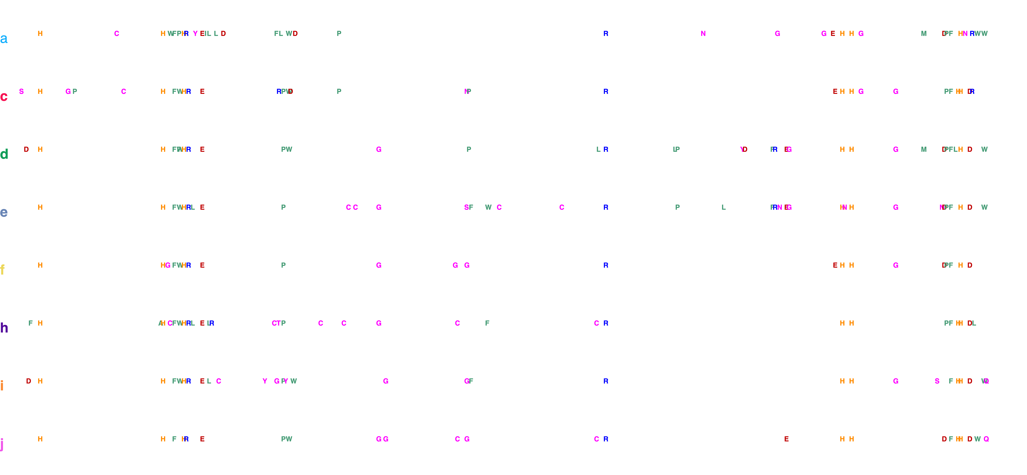
Cu_{A} binding motif
Cu_{B} binding motif

Slide 5
Cu_{A} binding motif
Cu_{B} binding motif

Slide 6
Cu_{A} binding motif
Cu_{B} binding motif

Slide 7
a
b
c
d
e
f
g
h
i
j

Slide 9

Coupled binuclear copper (CBC) proteins
Hemocyanins
Polyphenol oxidases
O₂ transportation
Tyrosinases
Catechol oxidases
O-Aminophenol oxidase
Monooxygenase + 2 e⁻oxidation
2 e⁻ oxidation
C-nitrosation

Slide 10
Coupled binuclear copper (CBC) proteins
Hemocyanins
Polyphenol oxidases
O₂ transportation
Tyrosinases
Catechol oxidases
O-Aminophenol oxidases
”O-methoxy phenolases”
Guaicyl
Syrringyl

Slide 12
i₁
i₂
i₃
i₄
i₅

Slide 13
Hydroxylation
Gauiacol
Demethoxylation and hydroxylation
Methoxy-ortho-diphenol
Syrringol

Slide 14
a
EC 1.14.18.1
EC 1.10.3.1
EC 1.10.3.4
b
Hydroxylation
AbPPO3
P-Coumaroyl unit (H)
Hydroxylation
MtPPO7, MtPPO-809,
MtPPO-010, CgPPO-473,
CgPPO-266, PpPPO-c2092
Guaiacyl unit (G)
Demethoxylation and hydroxylation
MtPPO7, CgPPO-1473,
CgPPO-266
Syringyl unit (S)

Slide 15
a
EC 1.14.18.1
EC 1.10.3.1
EC 1.10.3.4
b
Monophenolase
AbPPO3
P-Coumaroyl unit (H)
Monophenolase
MtPPO7, MtPPO-809,
MtPPO-010, CgPPO-473,
CgPPO-266, PpPPO-c2092
Guaiacyl unit (G)
Monophenolase + demethoxylation
MtPPO7, CgPPO-1473,
CgPPO-266
Syringyl unit (S)

Slide 16
Guaicyl
Syrringyl
Guaicyl
Syrringyl

Slide 17
a
Cu_{A} binding motif
Cu_{B} binding motif
b

Slide 18
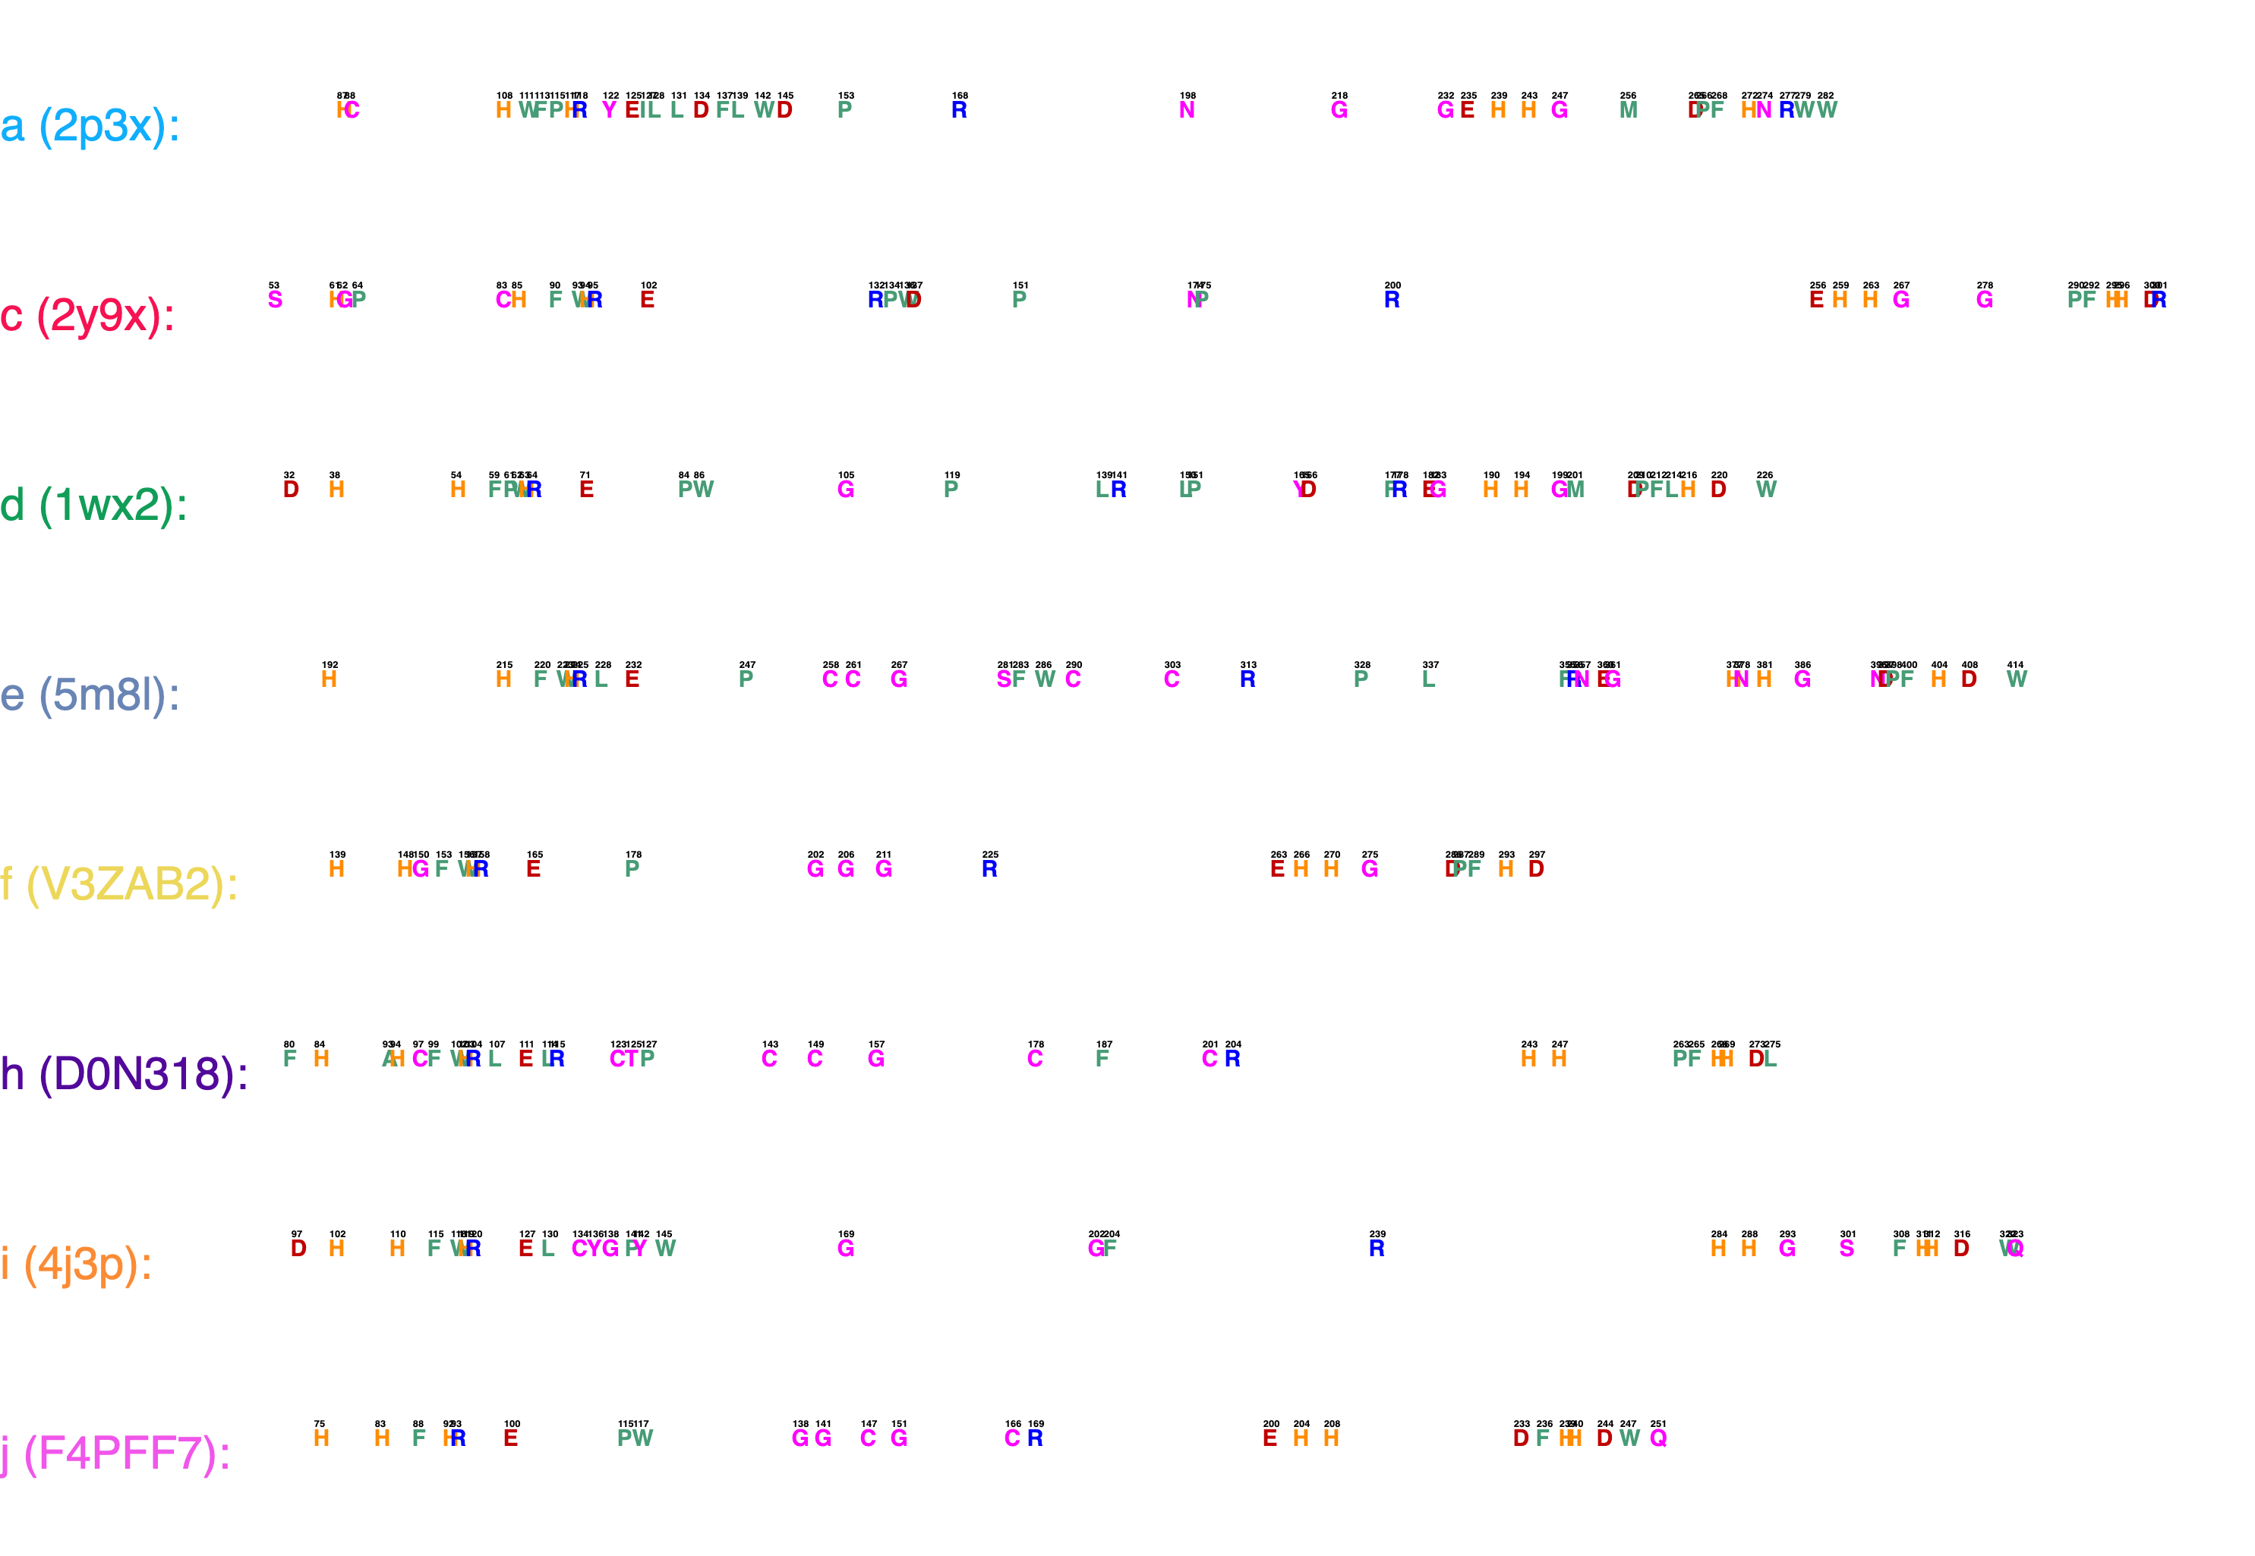
a
Cu_{A} binding motif
Cu_{B} binding motif
b

